Slide 1
Oracle Digital Assistant & Skillmatrix app - Integration
NAME
Laura Paraschiv
Gheorghe Digori
Notes:
This deck provides sales/se/sc training material for the “cloud native” sales play. It contains all the material in the 101 Customer Deck-Version A and additional content. If you plan to use Version B of the customer deck, please review that deck separately prior to your meeting.

Slide 2
Agenda
Basic Concepts
Overview
Intents
Entities
Custom Components
Flows
Channels: Slack
Results: Example of test case

Slide 3
Basic Concepts
Intents — Categories of actions/tasks that users expect the skill to perform for them.
Entities — Variables that identify key pieces of information from user input that enable the skill to fulfill a task.
Both intents and entities are common NLP (Natural Language Processing) concepts.
NLP is the science of extracting the intention of text and relevant information from text.
Components — Provide the skill with various functions so that it can respond to users. These can be generic functions like outputting text, or they can return information from a backend and perform custom logic.
Flows — The definition for the skill-user interaction. The dialog flow describes how the skill responds and behaves according to user input.
Channels — Users access Digital Assistants through messaging platforms or through client messaging apps. Channels, which are platform-specific configurations, allow this access. A single digital assistant or skill can have several channels configured for it so that it can run on different services simultaneously. Example of Channels: Facebook Messenger, Slack etc.

Slide 4
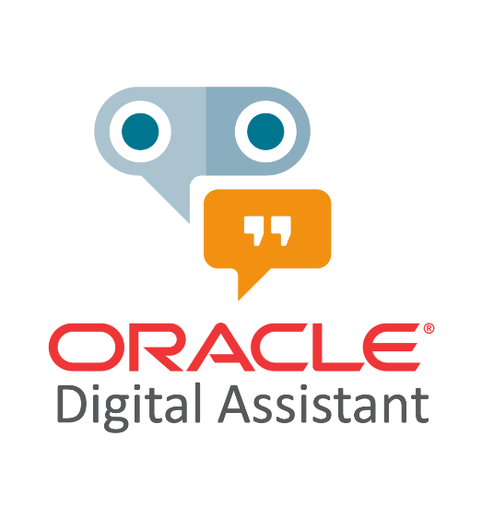








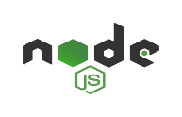

TENANCY
COMPARTMENT
Overview
129.213.112.84
Slack
Autonomous
JSON Database
Object
Storage
ADB API
How are
my team skills?
Web Browser
NoSQL API
NoSQL Database
Public Regional Subnet
MySQL API
MySQL Database
VCN

Slide 5
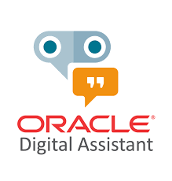
Overview
This Oracle Digital Assistant has 1 Skill with the following components:
- 9 Intents:
Bye: bye, exit etc. examples
Help: help, assist me etc. examples
ProvidedEngineer: all engineers names examples
SelectedManager: all managers names examples
ShowAreas: areas names and show areas examples
ShowManagers: managers names and show managers examples
ShowSkills: skills names examples
Start: Hello, Hi, Hey, Good Morning etc. examples
unresolvedIntent
- 1 Entity:
SkillValue: with values between 0-5
- 1 Custom Component:
managerEmployee: with 9 services to access REST service for querying data
This skill helps the user complete a task through a combination of button text messages or input text like “show managers” or “Python”.

Slide 6
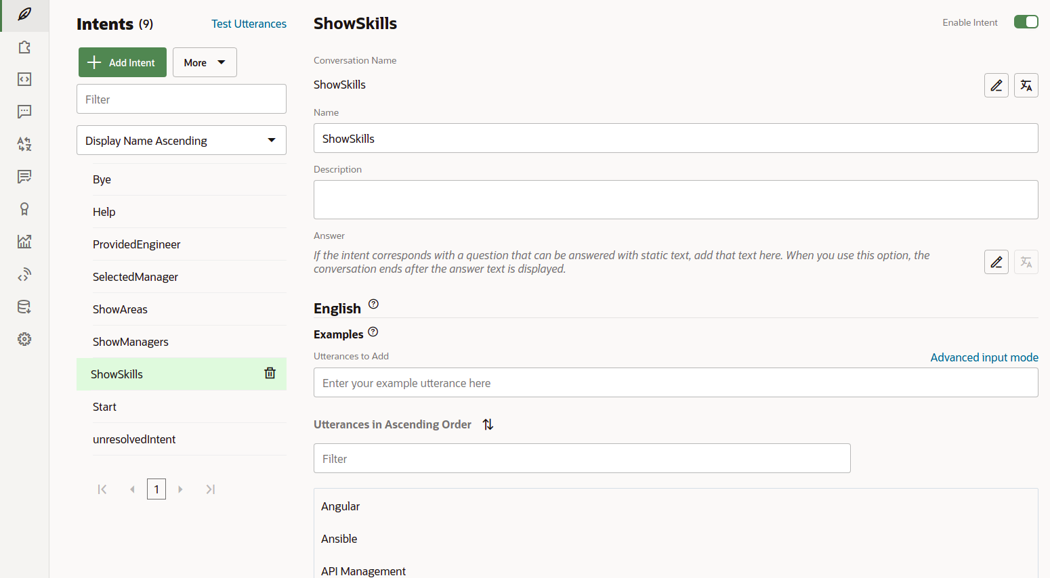
Intents

Slide 7
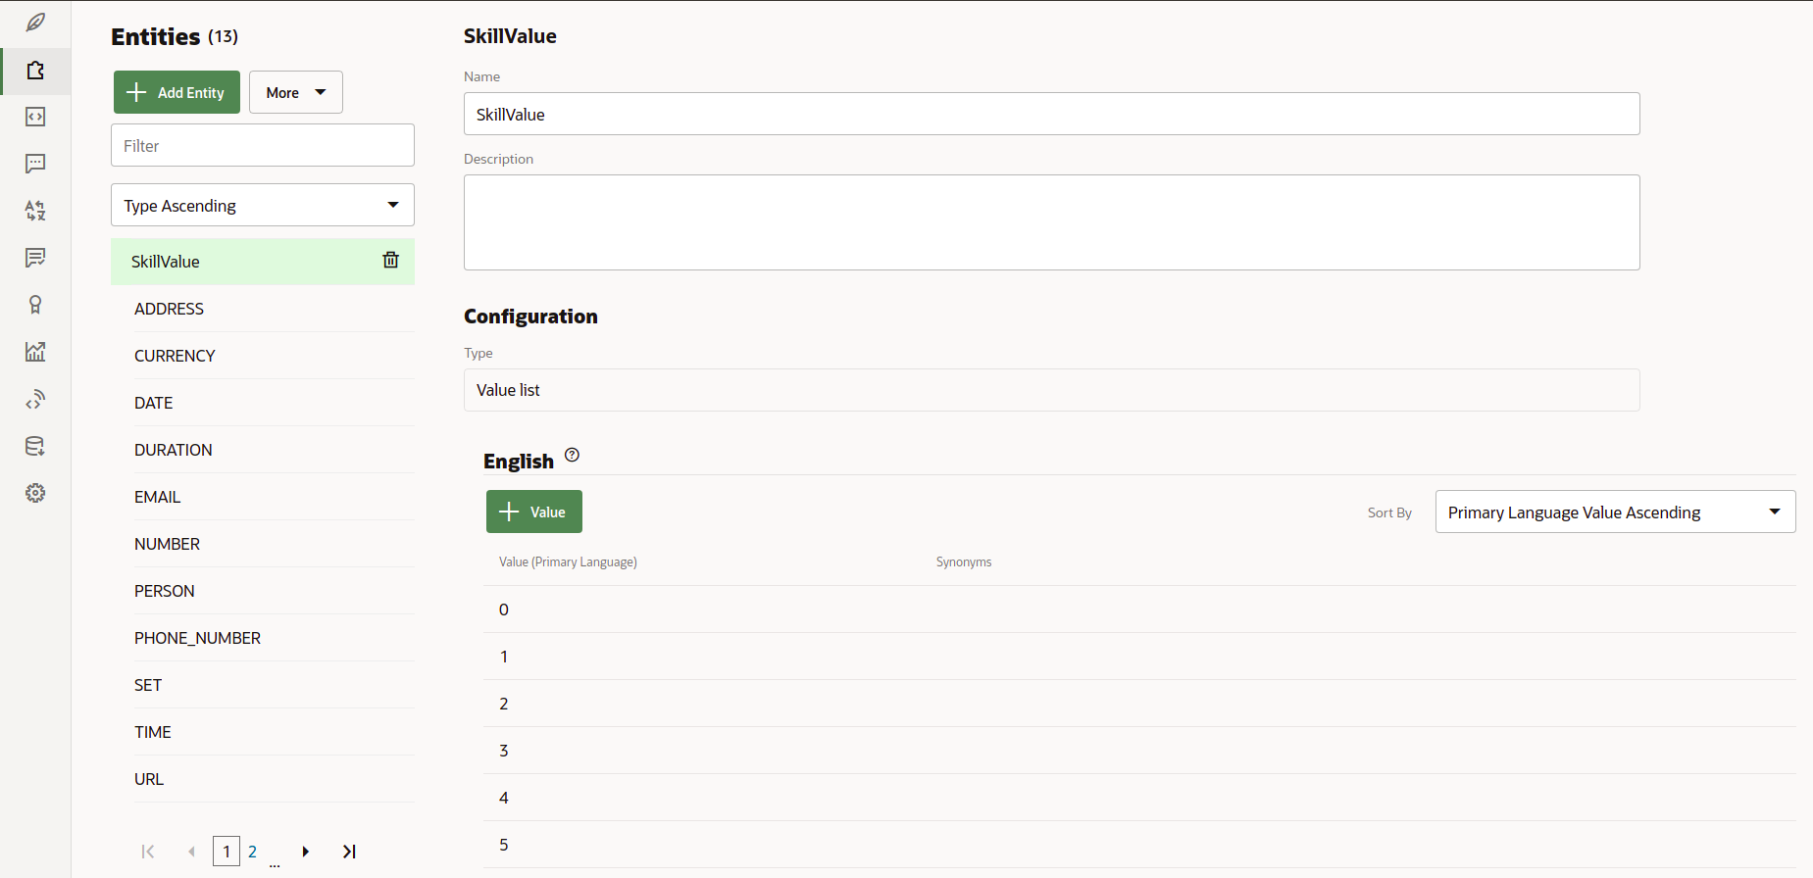
Entities

Slide 8
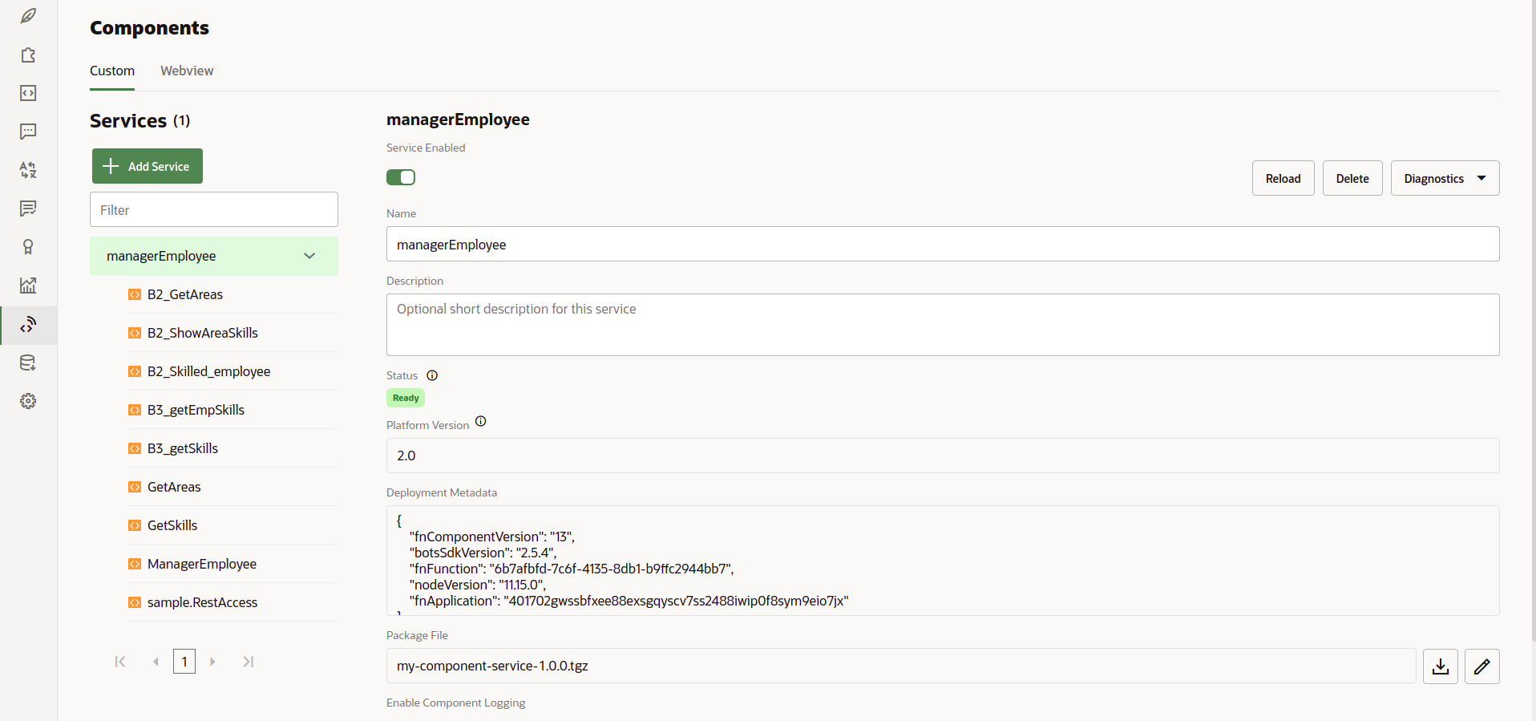
Custom Components

Slide 9
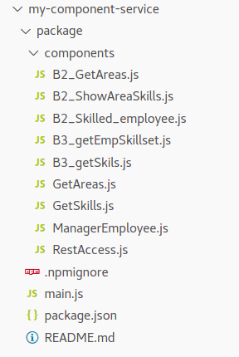
The custom component consists of 9 Node.js files and it’s structure can be viewed in the below picture:

Slide 10
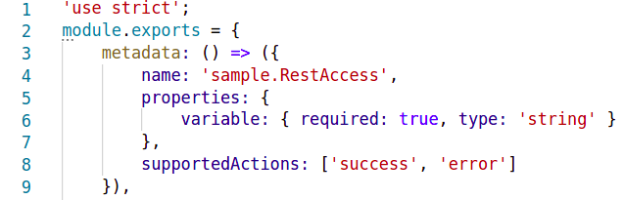
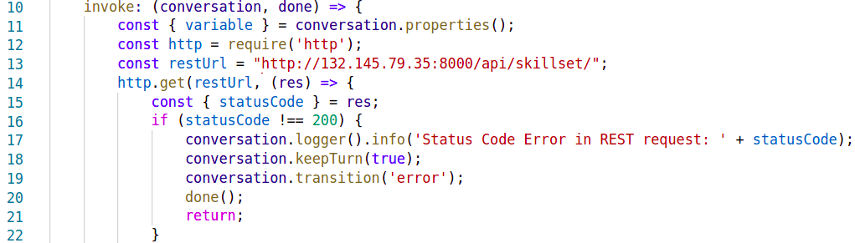
RestAccess.js in detail
The custom component metadata becomes the component interface signature after the custom component is registered with a skill in Oracle Digital Assistant.
The parameter “variable” will hold the name of the dialog flow variable that should get the data array at the end of the REST query.
The “restUrl” is provided as a static string in the source code. Line 12 provides a handle to the http module.
If the status of the GET request is not 200, then the component transitions to an “error” state that is defined in the dialog flow. For this, the metadata section of the custom component has an "error" and a "success" action defiled.

Slide 11
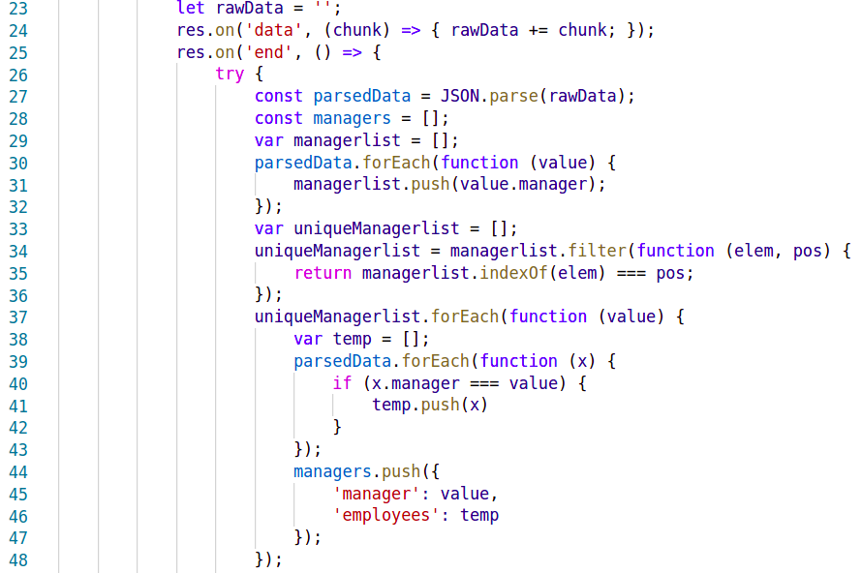
The http module allows you to listen for the "data" event and the "end" event.
The “data” event is used to fetch data from the REST service call. The "end" event then is used to parse the collected data. In line 27, the REST JSON string response is parsed into a JSON object.
Next, the JSON object is parsed and the manager values are pushed into “managerlist” which is filtered in the next step to have unique values.
Next, the uniqueManagerlist and the JSON object are parsed and push in managers list the manager value and employee names.

Slide 12
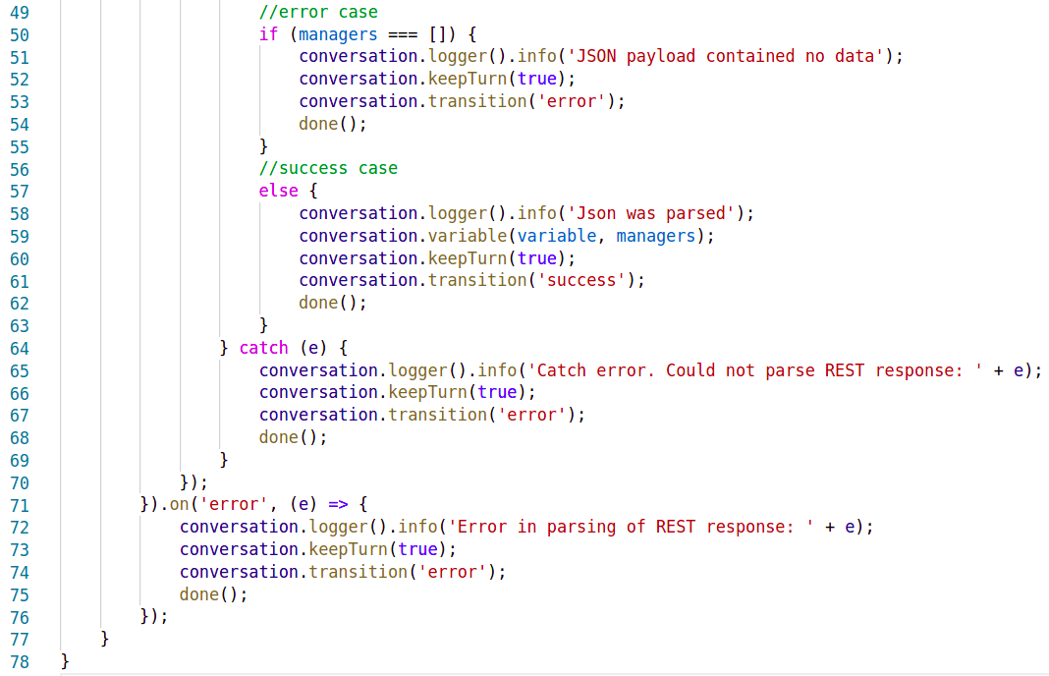
If the managers list is an empty list then the status will be “error” and will exits.
If the managers list is not empty, the status attribute in the JSON response of the Skillmatrix REST service used for this article has a value of "success", then, as shown in the right image the custom component can return the managers array to the skill where it is saved in a dialog flow variable.
The custom component has an input parameter "variable" defined that holds the name of the variable to update with the queried data. The transition triggered by the component is to the "success" action transition.

Slide 13
Managers and teams FLOW
Areas and Skills FLOW
Intents
Intents
Start
Start
GetAllManagers
GetAllAreas
ShowManagers
ShowAreas
GetEmployees
ShowAreaSkills
ShowEmployees
ShowAllSkills
GetAreas
resetVariables
ShowEmployeeAreas
askSkillValue
GetSkills
GetSkilled
ShowEmployeeAreasSkills
ShowSkilled_employee
EndMessage
printSkillValue

Slide 14
Channels: Slack
Below are the steps for creating a Slack channel for Digital Assistant.
Step 1: Get a Slack Workspace
Step 2: Create a Slack App
Step 3: Add OAuth Scopes for the Slack App
Step 4: Add the App to the Workspace
Step 5: Create a Channel in Digital Assistant
Step 6: Configure the Webhook URL in the Slack App
Step 7: Test Your Bot in Slack
For detailed steps use the the below link:
https://docs.oracle.com/en-us/iaas/digital-assistant/doc/slack.html

Slide 15
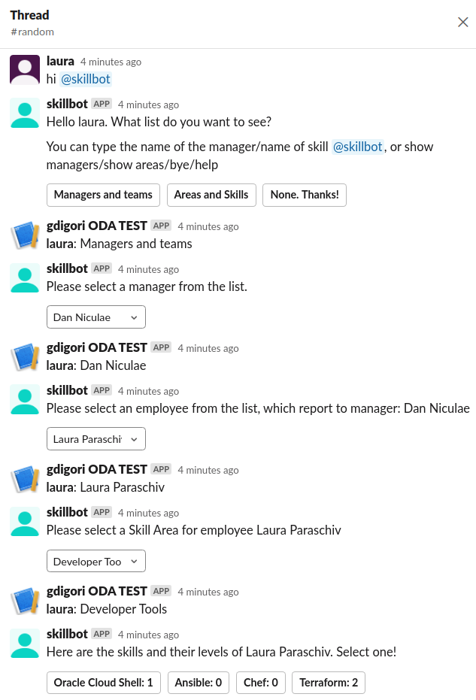
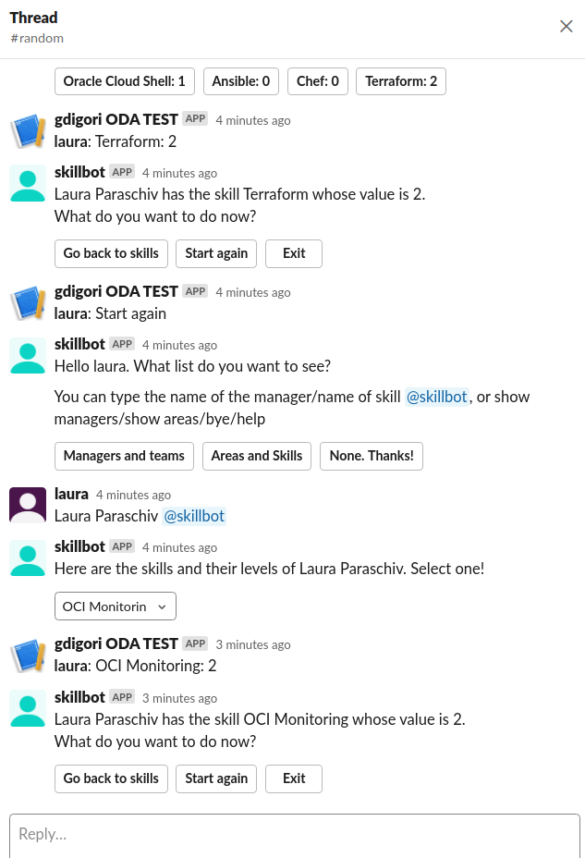
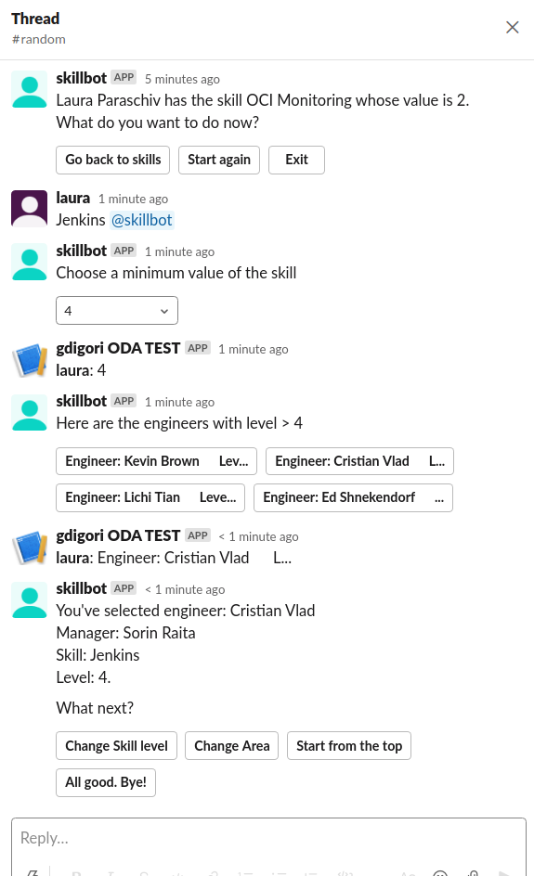
Results: Example of test case

Slide 16
Thank You
NAME
Laura Paraschiv
Gheorghe Digori
Copyright © 2020, Oracle and/or its affiliates | Confidential: Internal/Restricted/Highly Restricted
[Date]

